Slide 1

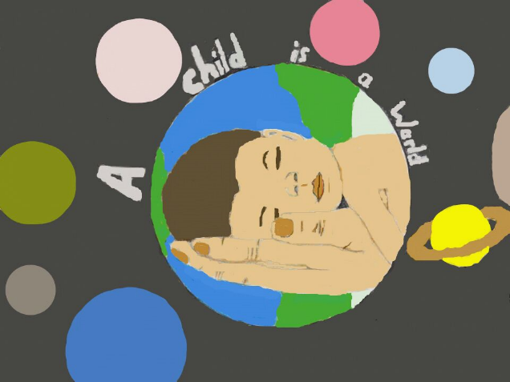
A child is a world

Slide 2
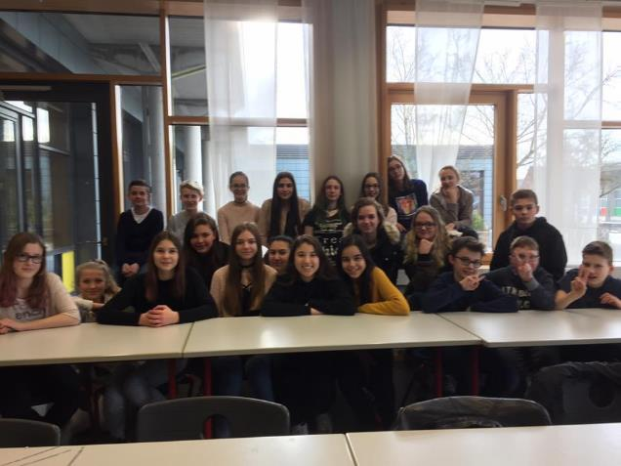
Erasmus Group at Leonardo da Vinci Gesamtschule

Slide 3
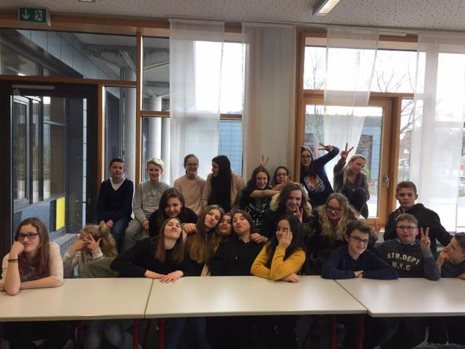
Erasmus Group at Leonardo da Vinci Gesamtschule

Slide 4
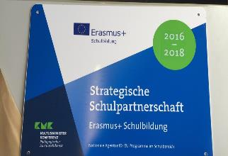
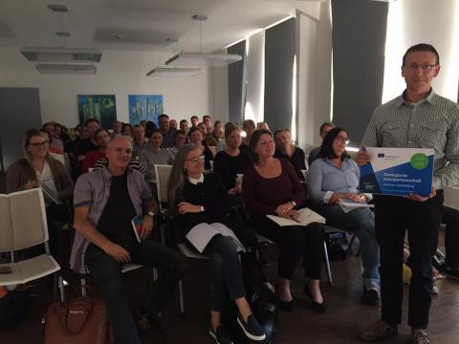
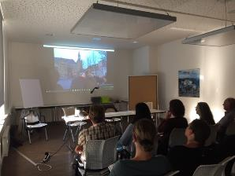
Erasmus seminar at Leonardo da Vinci Gesamtschule

Slide 5
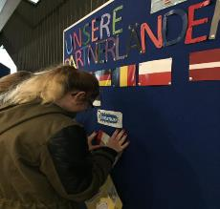
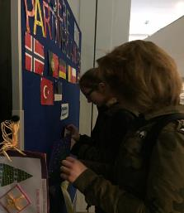
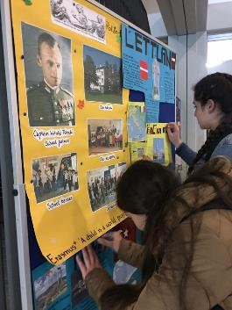
2016 – 2017 Erasmus – Corner

Slide 6
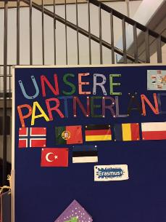
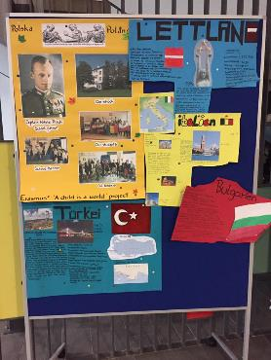
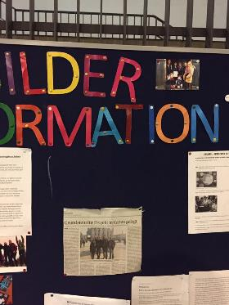
Erasmus – Corner

Slide 7
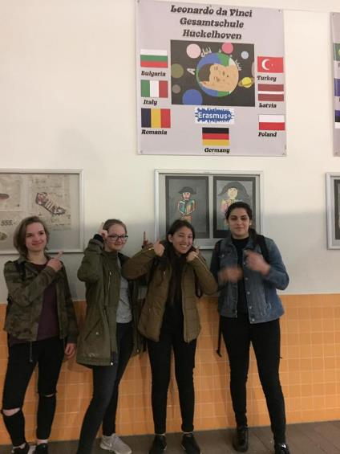
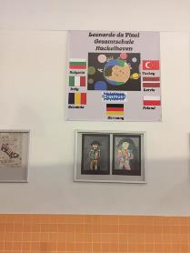
Erasmus – Corner

Slide 8
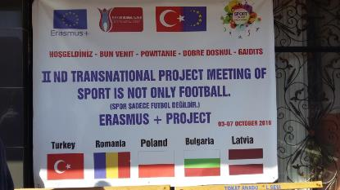
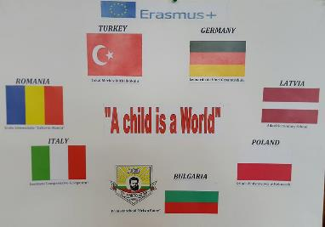
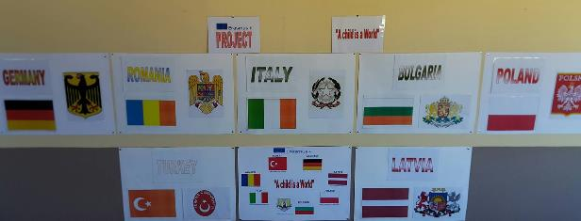
Corner from our Partner

Slide 9
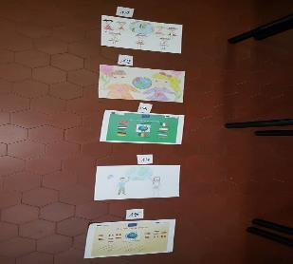
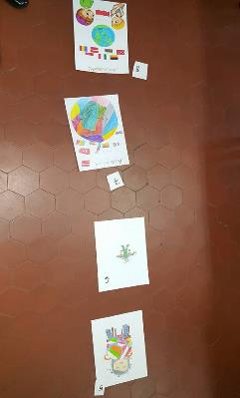
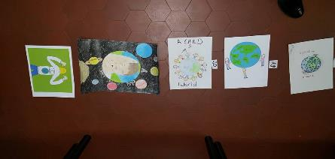
Logo - challenge

Slide 10
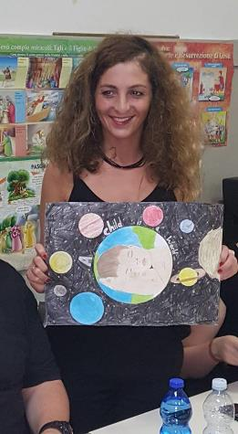
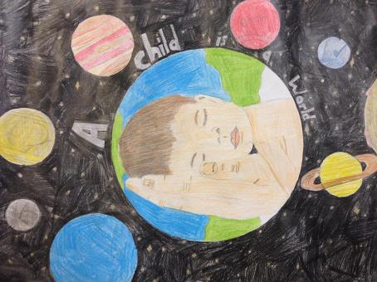
Logo – Eda Sezgin (7a)

Slide 11
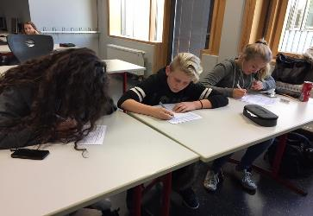
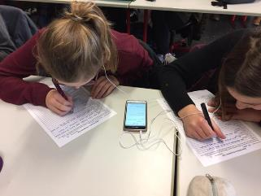
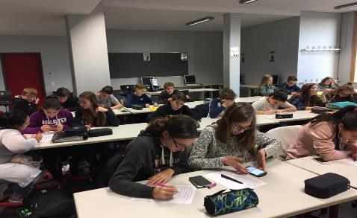
Questionnaires

Slide 12
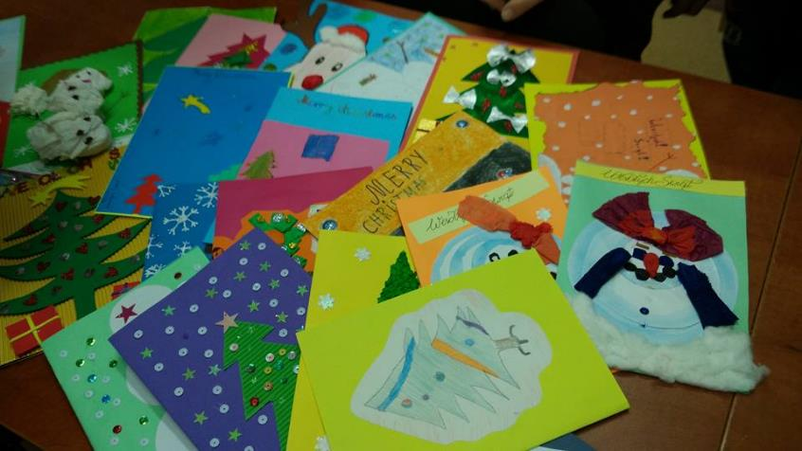
Christmas-cards

Slide 13
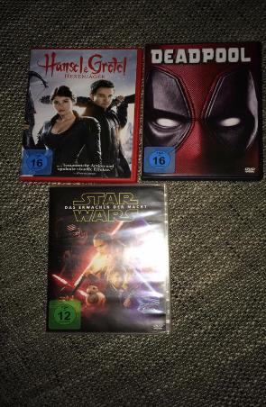
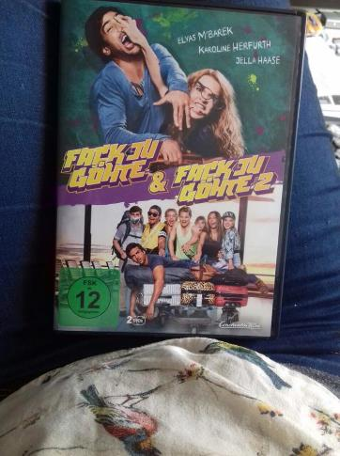
Cinema at Leonardo da Vinci Gesamtschule

Slide 14
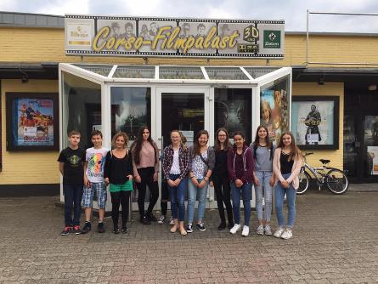
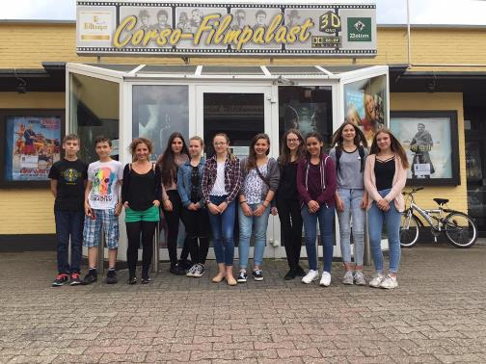
Cinema in Hückelhoven

Slide 15
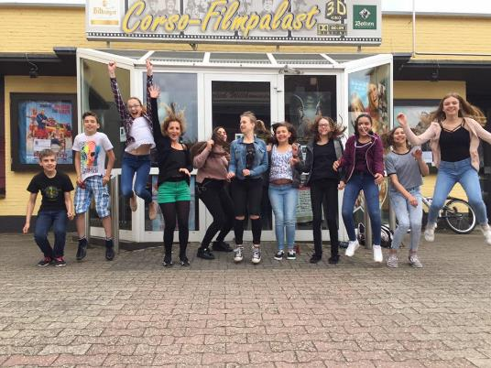
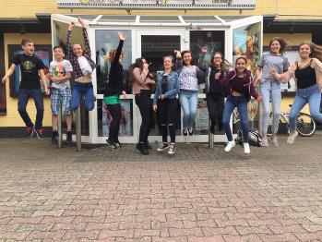
Cinema in Hückelhoven

Slide 16
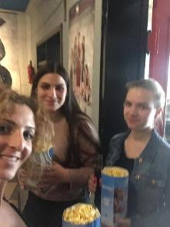
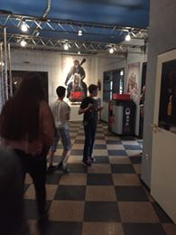
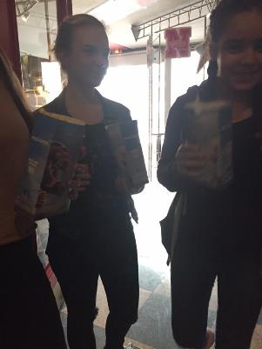
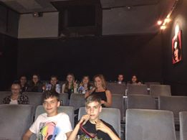
Cinema in Hückelhoven

Slide 17
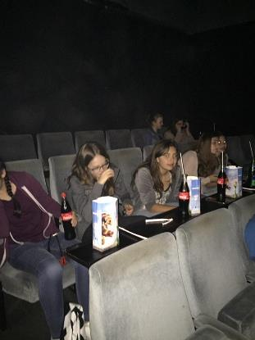
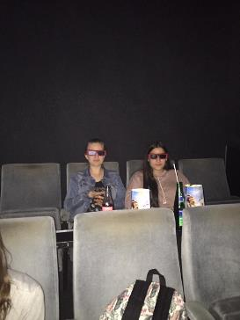
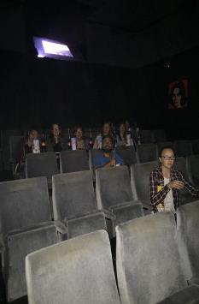
Cinema in Hückelhoven

Slide 18
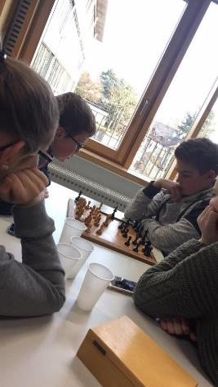
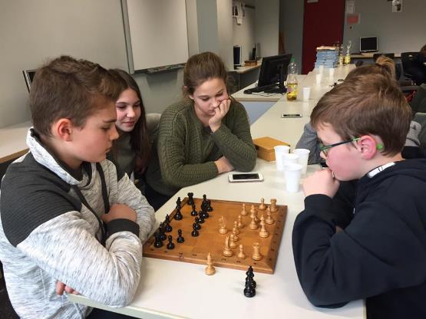
Chess - Tournament

Slide 19
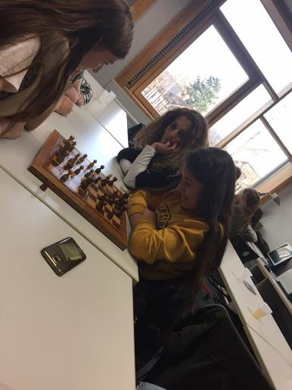
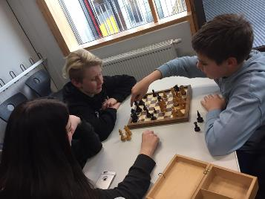
Chess – Tournament

Slide 20
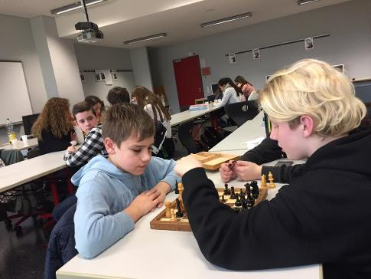
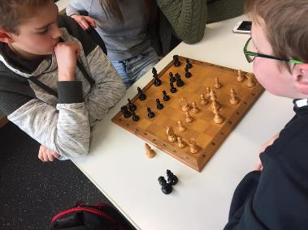
Chess – Tournament

Slide 21
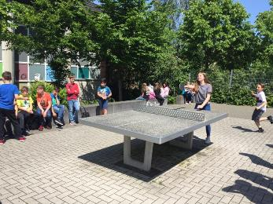
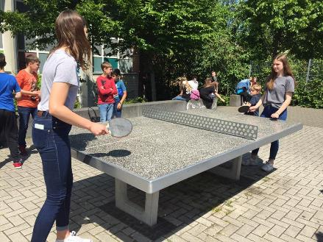
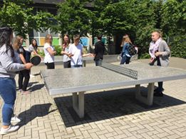
Tennis – Tournament

Slide 22
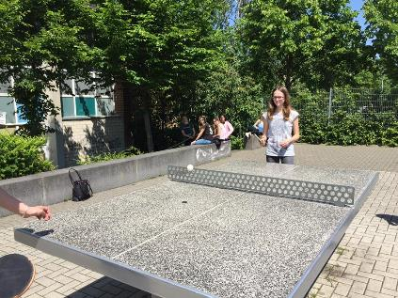
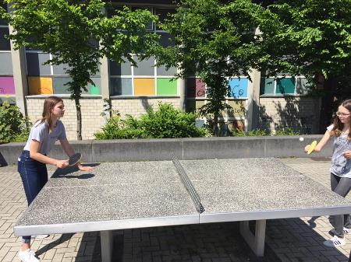
Tennis – Tournament

Slide 23





Tennis – Tournament

Slide 24



Poems

Slide 25



Poems

Slide 26



Poems

Slide 27



Poems

Slide 28




Growing Flowers

Slide 29



Growing Flowers

Slide 30






Growing Flowers

Slide 31






Growing Flowers

Slide 32





Other activities playground, boating, ice, park…

Slide 33


2017-2018

Slide 34






Slide 35




Slide 36






Slide 37


Slide 38

Winner – Poem Challenge

Slide 39

Cinema

Slide 40



Slide 41




Chess - Challenge

Slide 42


Winner – Chess

Slide 43


Activities – be together – work together

Slide 44





Slide 45



Slide 46





Slide 47


Slide 48




Slide 49






Slide 50



News at Leonardo da Vinci Gesamtschule

Slide 51

Evaluation – Romania Meeting

Slide 52

Präsentations

Slide 53


Newspaper

Slide 54




Slide 55
Films…
https://youtu.be/GeotjBr6DKw
→ Romania Meeting
https://youtu.be/3snEvUumnY4
→ Latvia Meeting
https://www.youtube.com/watch?v=N2rg9nNFXms
→ Germany Meeting

Slide 56
HomePage
Link→
https://achildisaworld.wordpress.com/

Slide 57

Homepage

Slide 58


Evaluation of Erasmus

Slide 59

Poland Meeting

Slide 60


Slide 61


Slide 62


Turkey-Meeting May 2018

Slide 63
Aims of our Project
making new friends
developing social skills – learing how to communicate
getting to know new things
getting to know your closest invironment and cultural heritage
gaining self-confidence/ accepting yourself
improving your skills
finding hobbes and interests
getting to know how to deal with your problems or finding a person to talk with (teacher)
gaining responsibility for your own life
being a better student ( getting help with education problems)
improving language skills

Slide 64
Activities of our Project
Preparing posters and information about the project
Taking tests about feelings prepared by my teacher
Taking with my teachers or other people ( social workers) about my feelings
Going to the cinema
Taking part in cultural trips and picnics
Going to other trips and workshops
Going to the theatre
Doing drama and theatre activities in company with coordinating teacher
Taking part in sports activities (chess, table tennis tournament)
Taking part in different competition ( e.g. singing, poety contest )
Preparing the school garden
Playing regional games

Slide 65
Do you like taking part in the project?
In the Beginning of project
At the End of project

Slide 66
Do you have any new friends thank to Erasmus project?
In the Beginning of project
At the End of project

Slide 67
Would you like to take part in Erasmus project next year?
In the Beginning of project
At the End of project

